Slide 1
QA Techniques: Review and Inspection
Dr Steffen Zschaler
Notes:
<CTRL-SHIFT-HOME><CTRL-SHIFT-2>
Welcome.
In this video, we will discuss a second quality-assurance technique: inspection.

Slide 2
Reviews and inspections
A group examines part or all of a process or system and its documentation
To find potential problems
Software or documents may be “signed off”
Signifies progress to the next development stage has been approved by management
Types of review (of different objects)
Inspections for defect removal (product)
Reviews for progress assessment (product and process)
Quality reviews (product and standards)
Notes:
The key idea with reviews and inspections is that a group of people examine a system or process, in its entirety or focused on some specific part, including its documentation.
The goal is to find potential problems and ensure they can be fixed before they cause issues.
Sometimes, a review or inspection is followed by a formal “sign-off” stage officially declaring the software or document quality checked and allowing it to move to the next stage in the development process.
We normally use a team of reviewers because review is a subjective assessment.
Different experts may identify different problems or may assess the severity of a problem in different way.
Using a team of reviewers helps to mitigate the subjectivity of the assessment and smooth out the differences between individual assessments.
We can identify different types of reviews: inspections of products aim to identify and remove defects. Products and processes can be reviewed to assess overall progress. Products and standards can be reviewed to assess their overall quality.

Slide 3
Phases in the review process
Pre-review activities
Review planning and review preparation
Review meeting
Author of document or program should ‘walk through’ the document with the review team
Post-review activities
Address problems and issues raised during the review meeting
Notes:
Every review process falls into three distinct phases:
Before the actual review meeting we need to plan and prepare the review. In particular, we need to ensure that the whole review team knows what they need to do.
During the review meeting, one person (often the original author) walks through the artefact to be reviewed with the review team, explaining the intent behind each part of the artefact in turn. Reviewers will give feedback, raise issues and comments, etc.
After the review meeting, we need a process to ensure that comments and issues raised during the review meeting are addressed. This will lead to a new version of the reviewed artefact, which may require another review but will definitely require some form of follow-up checks.
<ANIMATE>
The process can be summarised like in this diagram.

Slide 4
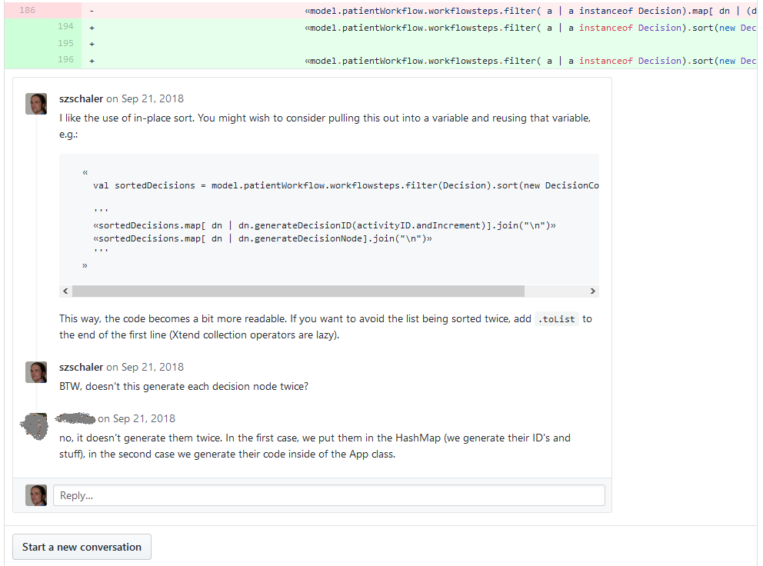
Distributed reviews
Suggested review team has face-to-face meetings
May be impractical for distributed teams
Remote reviewing using shared documents that can be annotated
Best example: Github PR reviews:
Notes:
While an in-person meeting has many benefits, it is often not practical to arrange one for every issue. Instead, distributed reviews have become more common over recent years.
Here, the artefact to review is shared remotely with the members of the review team, who deliver their comments and feedback through annotations to the document.
A typical example of this can be seen in GitHub’s use of pull requests and PR reviews as in the example here. Here, a reviewer can annotate individual lines of code and the original author can respond directly in the platform.

Slide 5
Program inspections
Inspections are peer reviews
Engineers examine system source aiming to discover anomalies and defects
Do not require system execution, so may be used before implementation
Can be applied to any representation of the system (requirements, design, configuration data, test data, etc.)
Have been shown to be effective for discovering program errors
Should be driven by a checklist of common errors
Programming-language dependent
Reflect characteristic errors likely to arise in the language
Rule of thumb: the ‘weaker’ the type checking, the larger the checklist
Examples: Initialisation, Constant naming, loop termination, array bounds
Notes:
Reviews are sometimes also called inspections.
An important point is that inspections can be applied to any representation of a system, so they can even be undertaken at the requirements or design stage, when no actual software is available yet.
Inspections have been shown to be effective for discovering program errors, especially when they are driven by a checklist of common errors.
Such a checklist can be fairly generic, independent of the specific problem being solved.
Typically, checklists need to be programming-language specific to ensure that typical error patterns in that programming language can be identified.
Some of these checks are already done automatically by a language’s compiler. However, the weaker the automatic checks (e.g., where there is no type system), the more extensive manual checks against longer checklists are required.

Slide 6
An inspection checklist example
Fault class | Inspection check
Data faults | Are all program variables initialized before their values are used? Have all constants been named? Should the upper bound of arrays be equal to the size of the array or Size -1? If character strings are used, is a delimiter explicitly assigned? Is there any possibility of buffer overflow?
Control faults | For each conditional statement, is the condition correct? Is each loop certain to terminate? Are compound statements correctly bracketed? In case statements, are all possible cases accounted for? If a break is required after each case in case statements, has it been included?
Input/output faults | Are all input variables used? Are all output variables assigned a value before they are output? Can unexpected inputs cause corruption?
Interface faults | Do all function and method calls have the correct number of parameters? Do formal and actual parameter types match? Are the parameters in the right order? If components access shared memory, do they have the same model of the shared memory structure?
Storage management faults | If a linked structure is modified, have all links been correctly reassigned? If dynamic storage is used, has space been allocated correctly? Is space explicitly deallocated after it is no longer required?
Notes:
Here is an example of a possible checklist for code inspection.
----
This completes our discussion of review and inspection. Go back to KEATS, where you will find the final phase of this week, which focuses on testing.
<CTRL-SHIFT-END>

